Slide 1
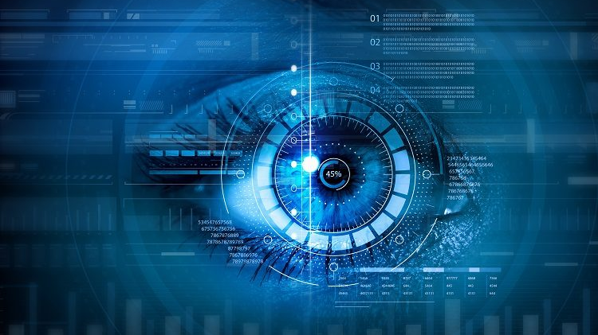
Image Classification with CIFAR-10
Presented by: Terrance Randolph

Slide 2
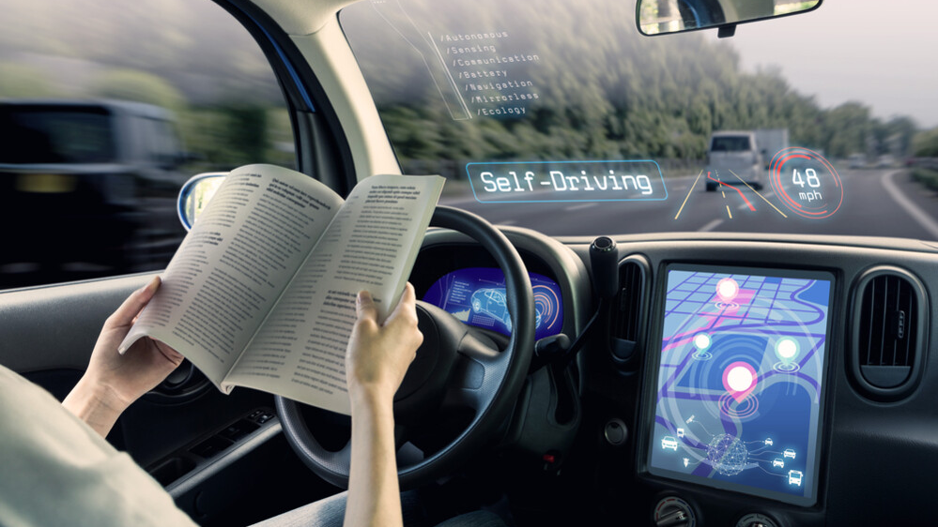
Importance of
Computer Vision
Government uses: US: Army National Guard, tracking Armory property. Law enforcement, scanning license plates. UK: automated land registry for buying and selling property
Popular commercial uses: self-driving cars, facial recognition, Amazon Go etc...
Notes:
Cinnamon
Law enforcement dash cameras are supported by smart software that can read license plates on moving vehicles, looking for stolen cars or supporting Amber Alerts.
Amazon Go stores - sensors enables customers to exit the store without stopping at a cash register, with purchases charged automatically to their Amazon accounts.
DermLens is used to identify and monitor psoriasis in patients and help track their progress.
Gauss Surgical offers a real-time blood monitor that analyzes pictures of surgical sponges in order to track blood loss during surgery

Slide 3
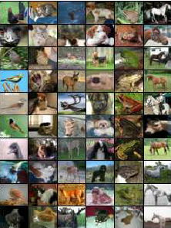
CIFAR-10 Dataset
The Canadian Institute for Advanced Research (CIFAR-10) dataset was collected by Alex Krizhevsky, Vinod Nair, and Geoffrey Hinton, in participation with research teams at MIT and NYU. Together they collected millions of tiny color online images.
10 categories
50K training images
10K test images
32x32 color (RBG)
Notes:
Cinnamon

Slide 4
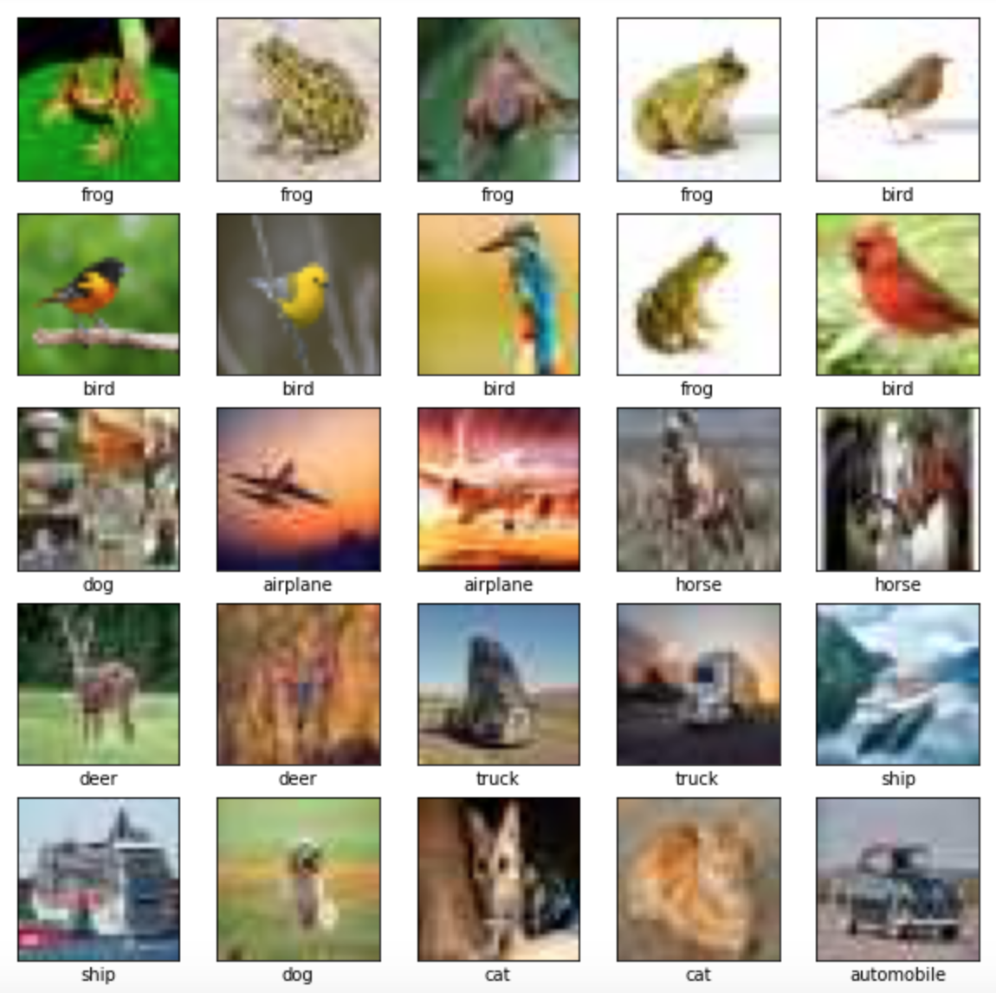
Custom Dataset
This dataset was compiled using images from the web and personal images provided by the team (including pet photos!)
10 categories
155 images
32x32 color (RBG)
Notes:
Cinnamon

Slide 5
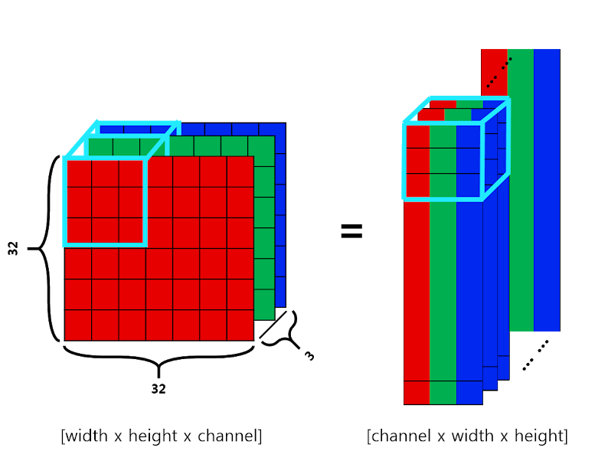
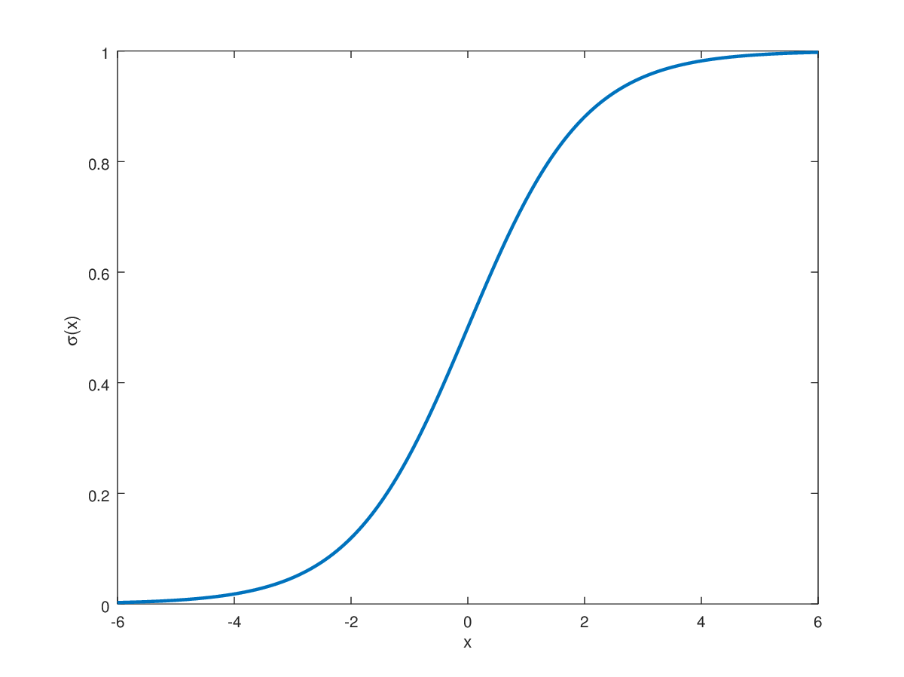
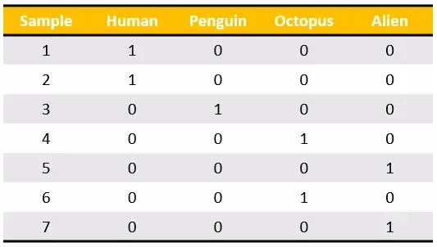
Data Preprocessing
Normalization
One-Hot Encoding
Reshaping
Pixel values changed from 0-255 to 0-1 (sigmoid activation)
Encode categorical integer features using one-of-K scheme
Creating a single channel
Notes:
Sigmoid Activation: Input transformed values between 0.0 and 1.0.
1 Hot Encoding: integer encoding is not enough…. 0 indicates non existent while 1 indicates existent.
Reshaping: 32 x 32 = 1,024 pixels flatten

Slide 6
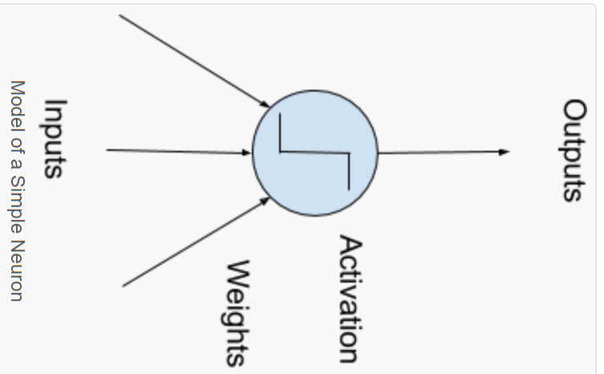
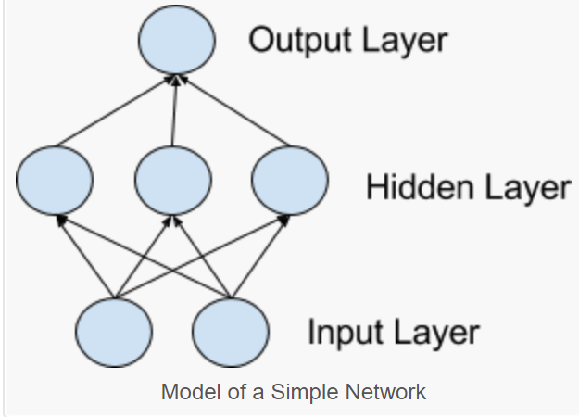
Data Preprocessing
Neurons
Networks of Neurons
Reshaping
computational units weighted input signals produce an output signal activation ‘relu’
hidden layers not directly exposed to input. Simplest network have a single neuron in a hidden layer that outputs values
Creating a single channel
Notes:
Sigmoid Activation: Input transformed values between 0.0 and 1.0.
1 Hot Encoding: integer encoding is not enough…. 0 indicates non existent while 1 indicates existent.
Reshaping: 32 x 32 = 1,024 pixels flatten

Slide 7
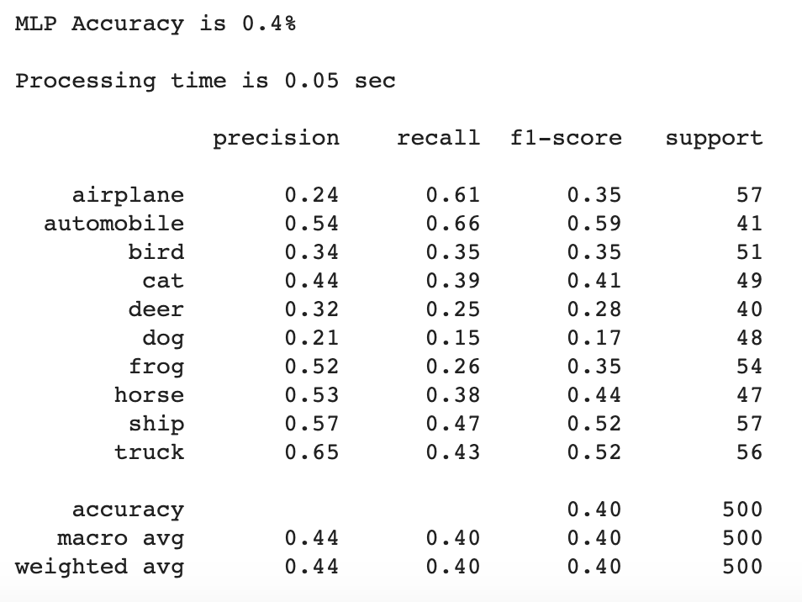
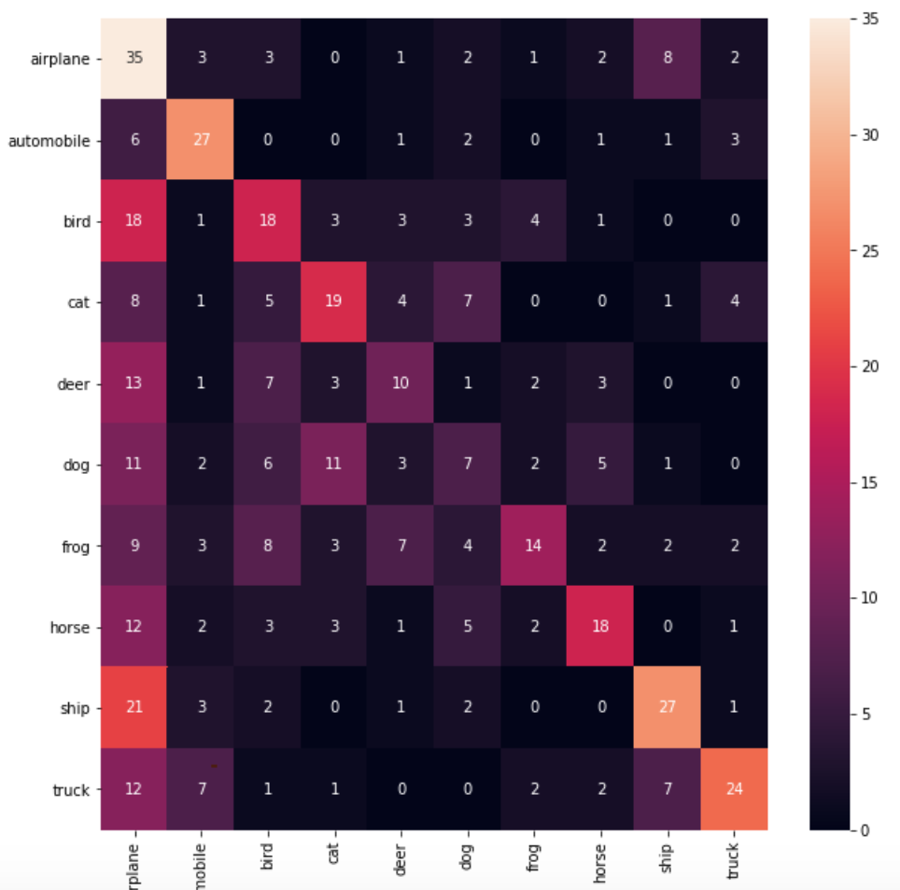
Multi-Layered
Perceptron

Slide 8
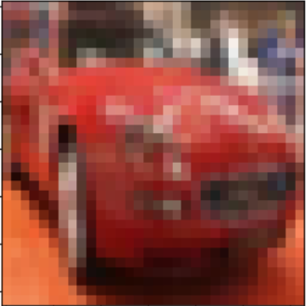

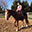

Multi-Layered
Perceptron
40%
Prob over 50%
Notes:
Single Neuron/Perceptron
Input is weighted by pixeland activiated ‘relu’

Slide 9
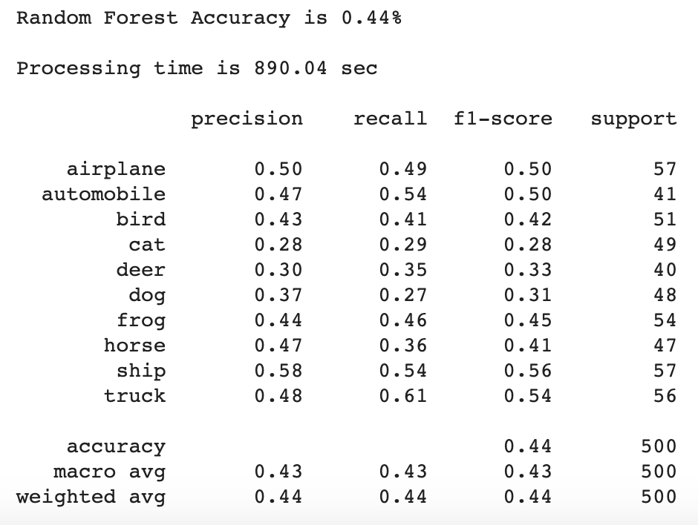
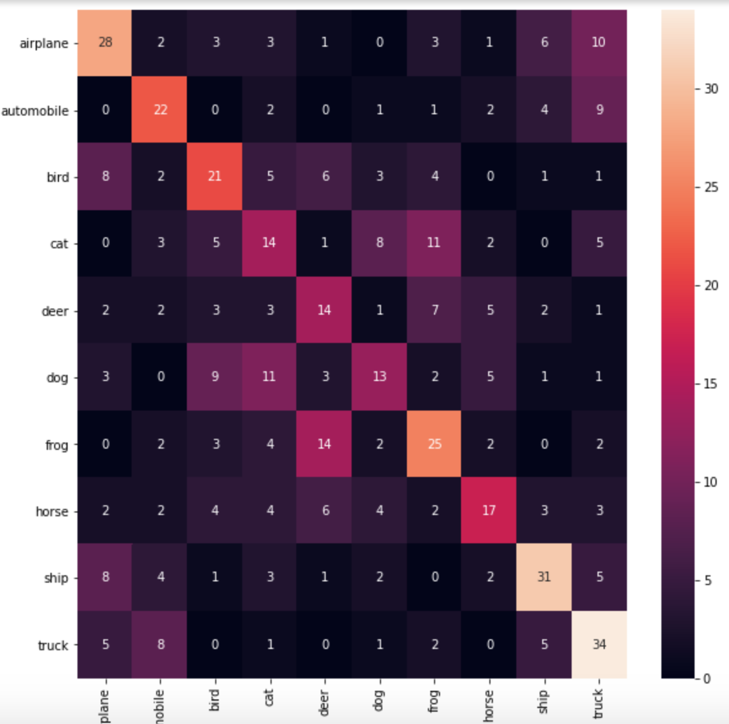
Random Forest
Notes:
Rod

Slide 10

Random Forest
44%
Prob over 50%
Notes:
Rod

Slide 11
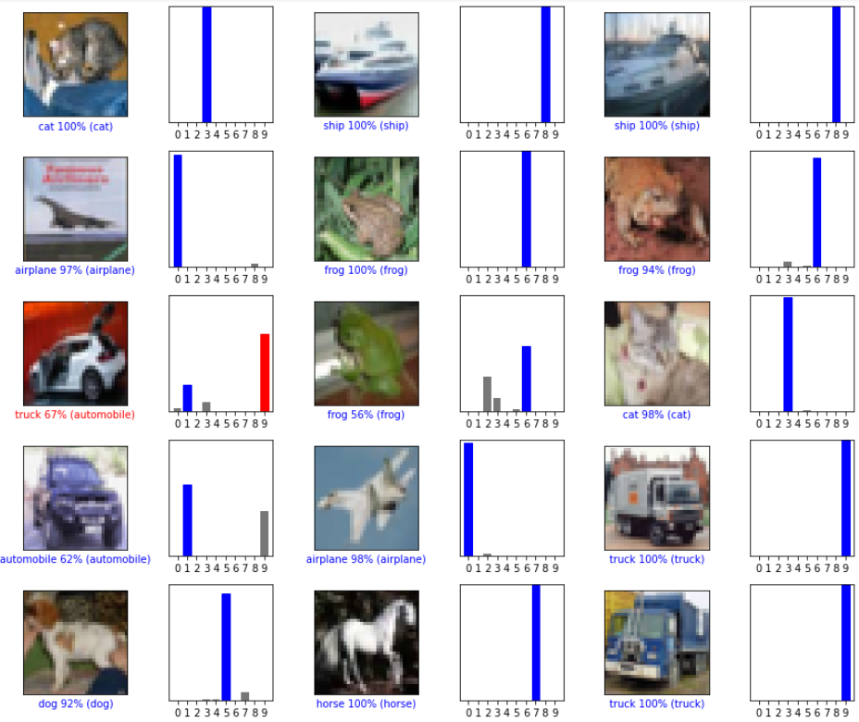
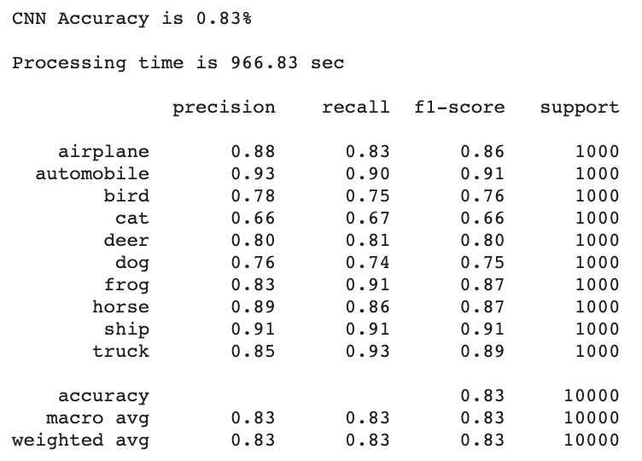
Convolutional
Neural Network
Notes:
Rod

Slide 12
Convolutional
Neural Network
Low Prob. Variation
83%
Low Prob. Variation
High Prob. Variation
Low Prob. Variation
Notes:
Rod

Slide 13
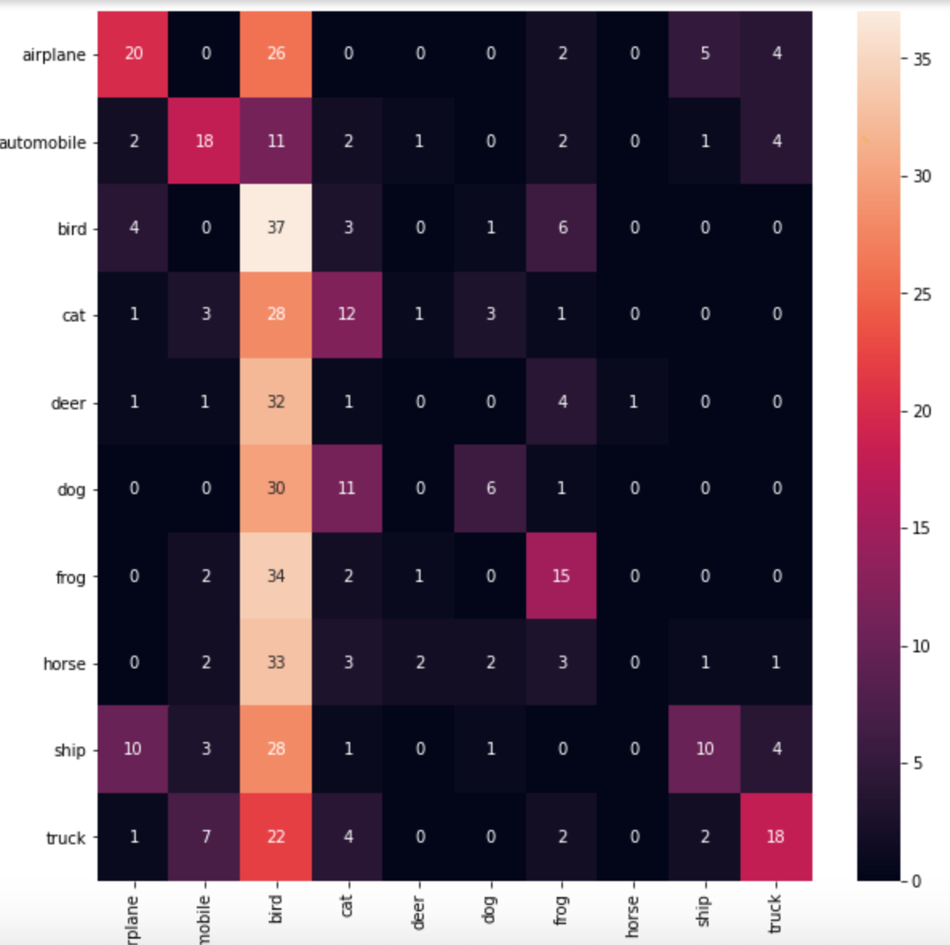
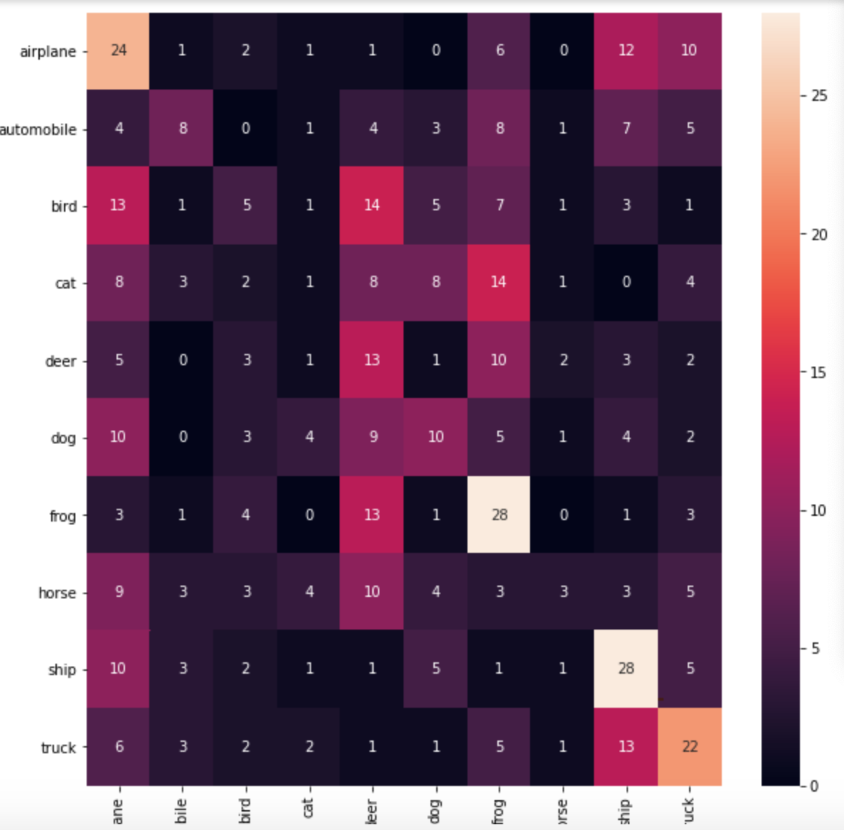
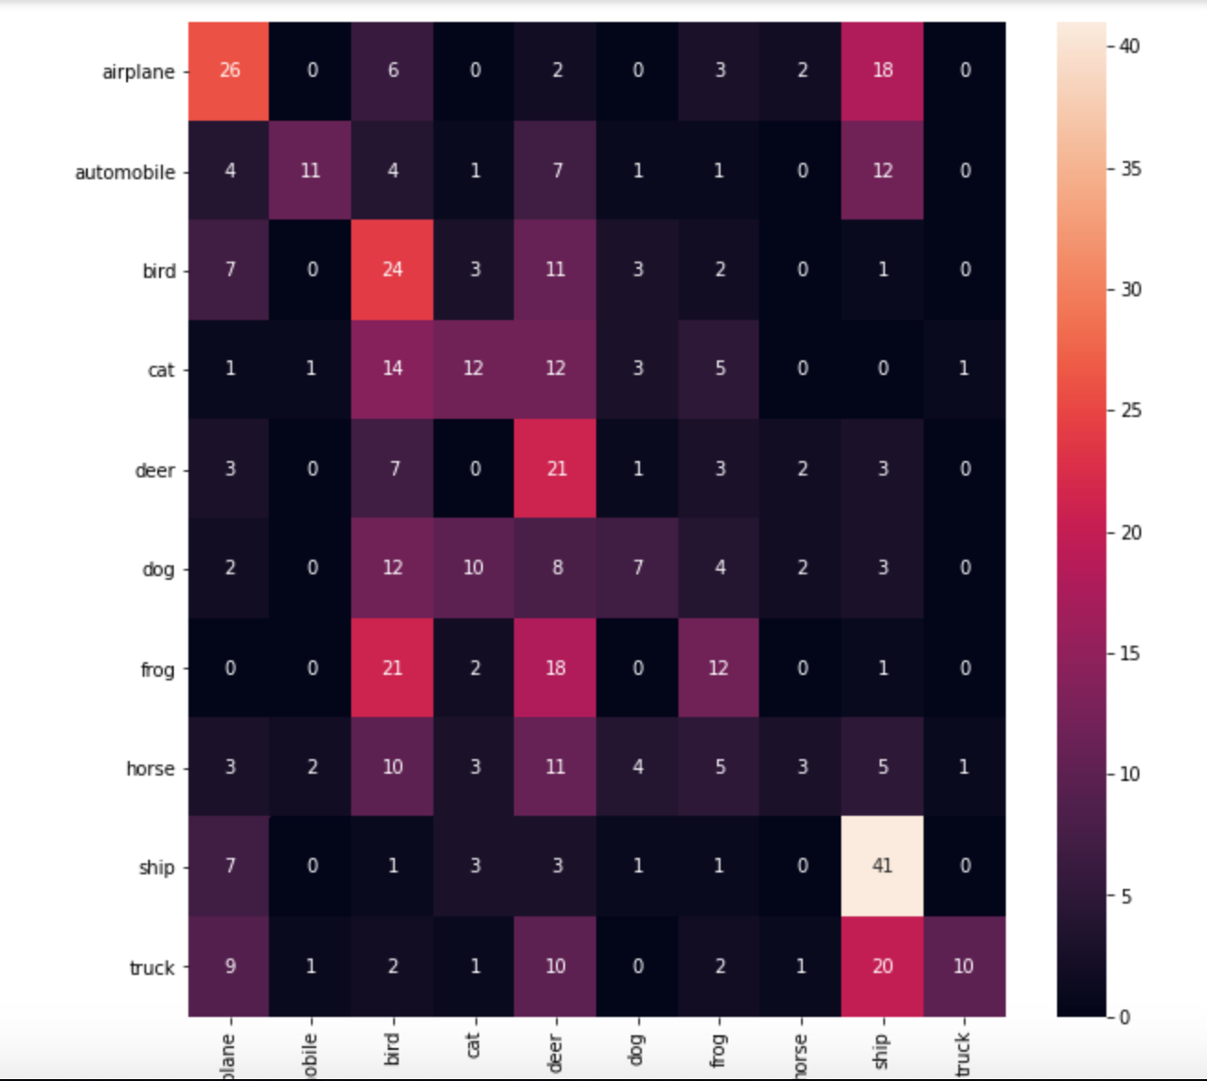
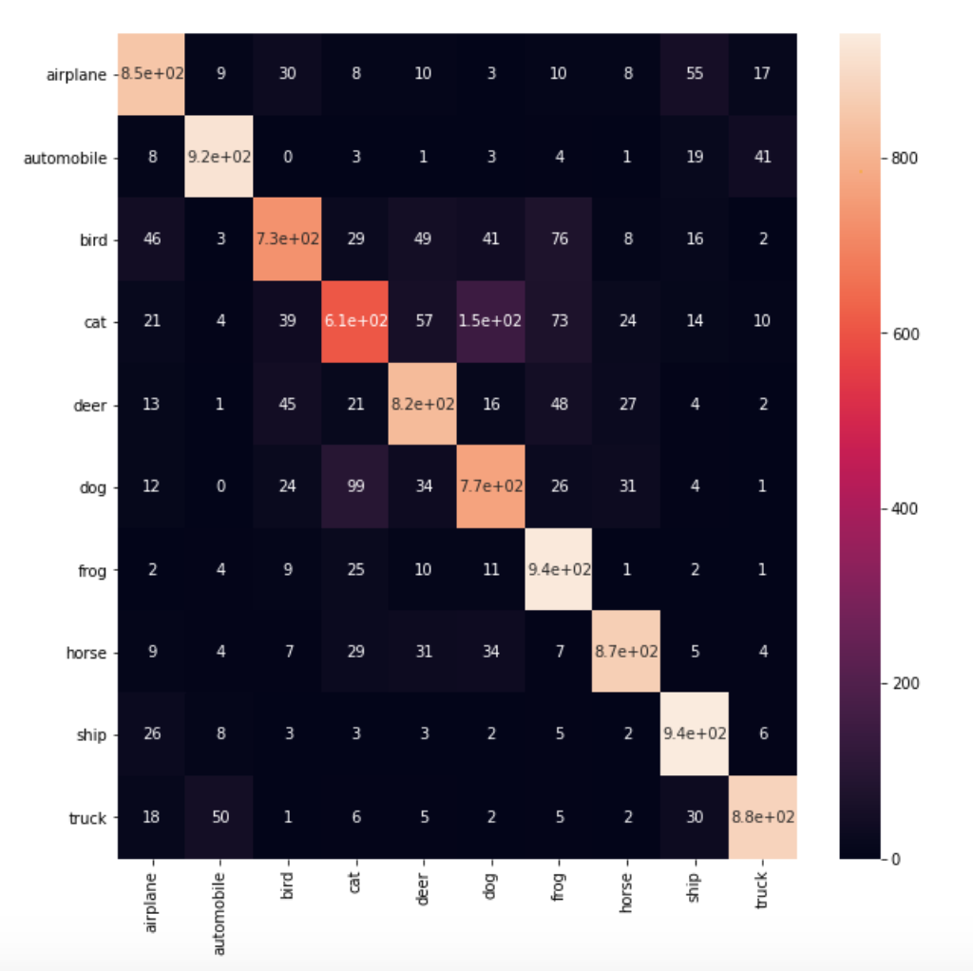
Model Snapshots - Confusion Matrices
Linear Classification
Naive Bayes
KNN
MLP
Random Forest
CNN
Bird Class
Deer
Frog
Dog
Bird
Cat
Deer
Ship
&
Truck
Notes:
Eric

Slide 14
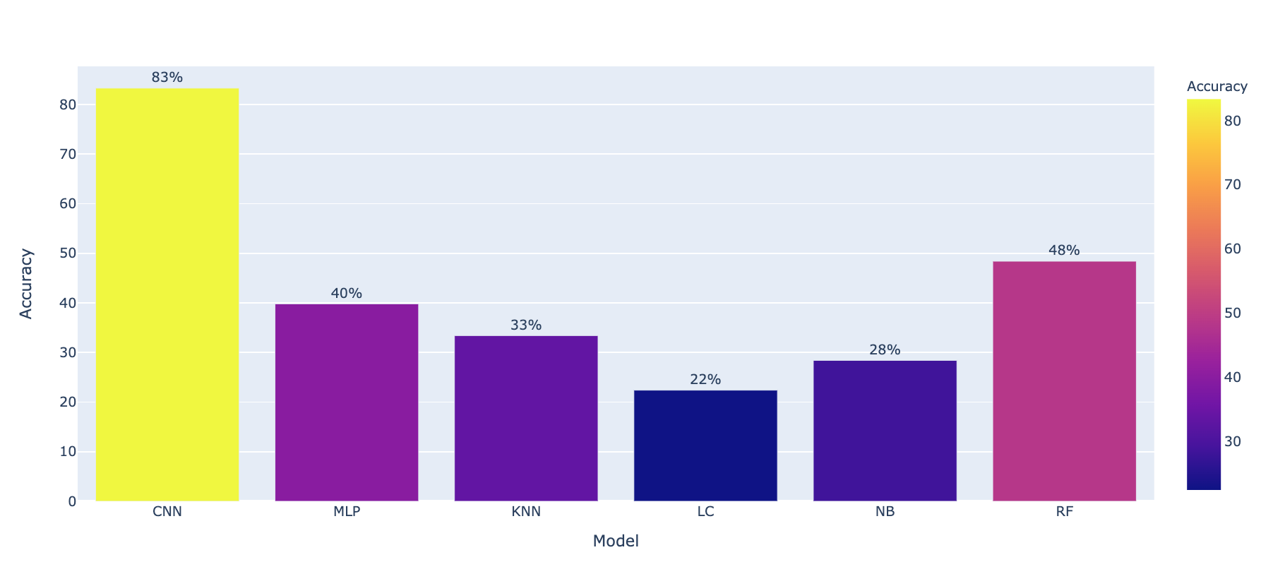
Model Accuracy
Need Improvement
Good
Notes:
Cinnamon

Slide 15
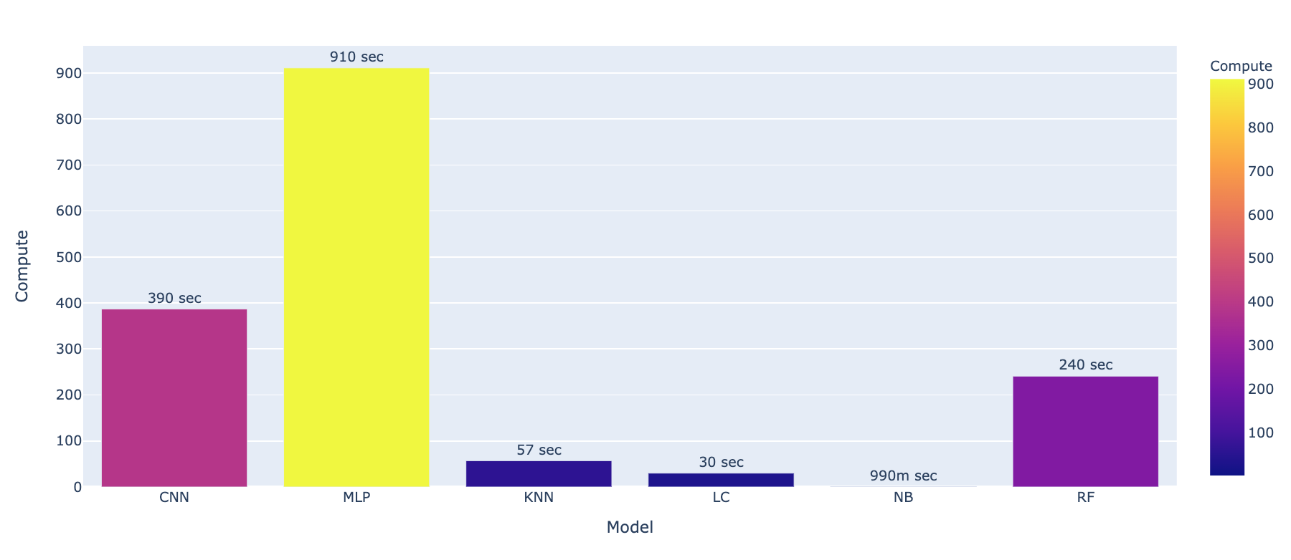
Model Compute Performance
6.5 mins
4 mins
Notes:
Cinnamon

Slide 16

Custom Dataset
Performance
I created a custom dataset to see how the model would fare with images from my personal collection and the internet
Notes:
Cinnamon

Slide 17
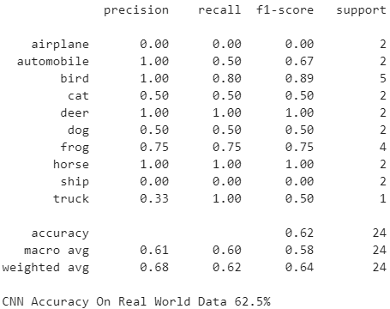
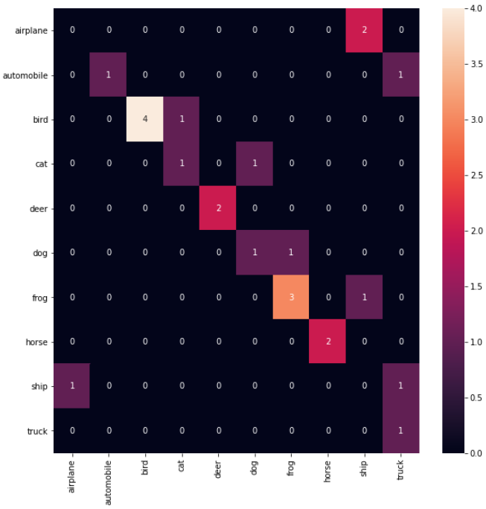
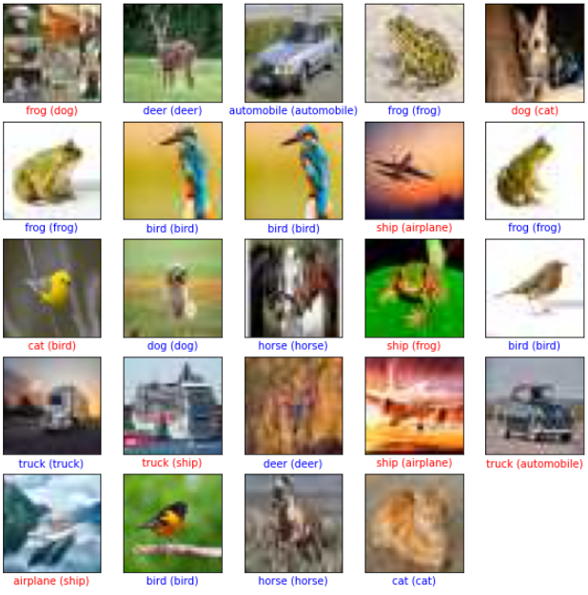
Best:
CNN Model
Bird
62%
Deer
Ship
Airplane
Notes:
Cinnamon

Slide 18
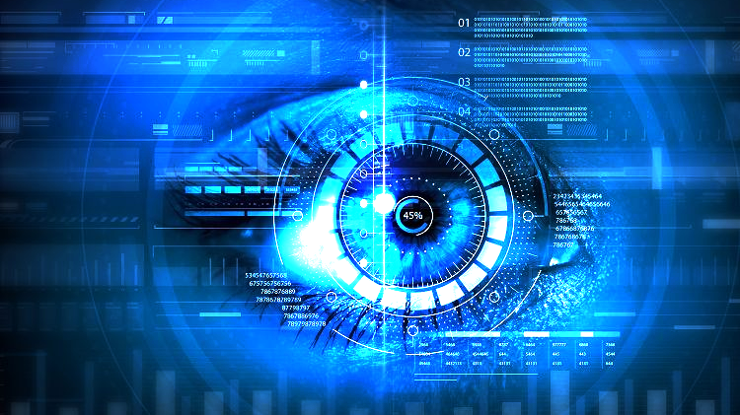
QUESTIONS?
Image Classification with CIFAR-10
Terrance Randolph

